Slide 1


A.L. Helbert-Etter, F. Brisset, T. Baudin
Université Paris-Sud 11
ICMMO, UMR CNRS 8182
LPCES, Bâtiment 410
91405 Orsay Cedex
Characterization of strained materials: correlation between EBSD investigations and TEM observations
Ecole des Mines St Etienne 5 mai 2010

Slide 2
TEM/EBSD correlation:
1- Stored energy in a cold rolled IF-steel
2- Phase hardening comparison in a cold-rolled α/γ steel
3- Sub-micron copper produced by ECAE

Slide 3
1- Stored energy in a cold rolled IF-steel
φ₁
40% CR
Annealed
{111}<112>
{111}<110>
Φ
Shift
Fibre
{111}<uvw>
ϕ₂ = 45°
ϕ₂ = 45°
Driving force in recrystallization = energy stored by grains during cold working
Stored energy
Neutron diffraction
TEM/EBSD (Dillamore)
(Samet, PhD, Orsay, 2005)

Slide 4
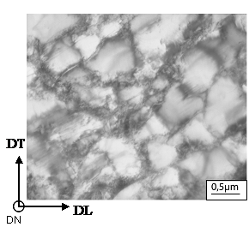
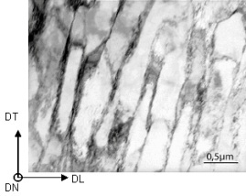
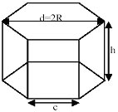
Stored energy : Dillamore approach
Energy = Energy stored inside cell walls
Misorientation between cells
(TEM/EBSD)
Grain
Cells
KV
γ
E
=
s
d
Cell morphology
(TEM)
Cell size
(TEM)
Equiaxed cells
Lamellar cells
DN
D
DL
d
h
DT
Parallelogram
Hexagon : h = d
K’ = 3,31/d
K’ = 1/d +1/h+1/D
(Samet, Etter, Baudin, Penelle, Mater. Sci. Eng. A, 2008)

Slide 5
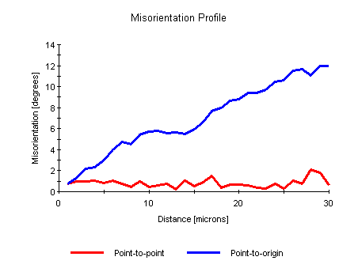

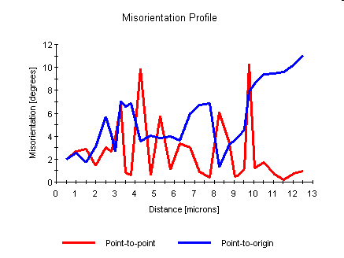
TEM sub-structures / EBSD cell misorientations
{111}<110>
E
= f(Δθ/d)
Equiaxed cells
3° mean misorientation
Orientation gradient
Energy (J/mol)
0.4°/µm
{111}<112>
Crystallographic orientations
Lamellar cells
7° mean misorientation
No orientation gradient
Components of low Energy develop during recrystallization

Slide 6
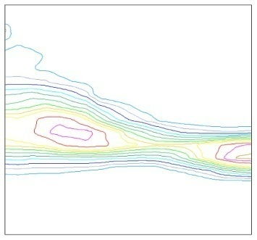
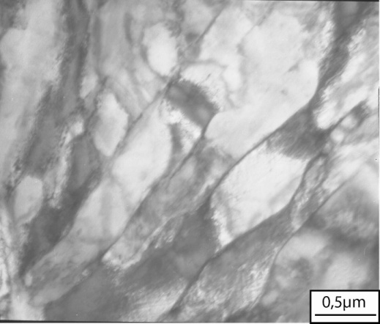
1- Stored energy in a cold rolled IF-steel
Conclusions
{111}<110>
{111}<112>
DT
Bulging
DL
DT
φ₁
DT
DL
{111}<110>
DL
Φ
Cellular sub-structure
+
Low energy
Fe-36Ni
Cu
Recrystallization

Slide 7
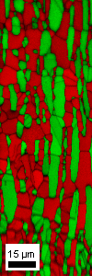
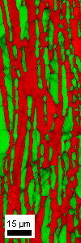
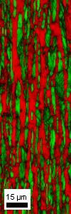
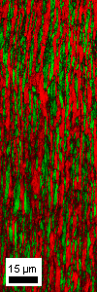
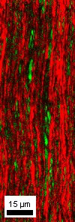
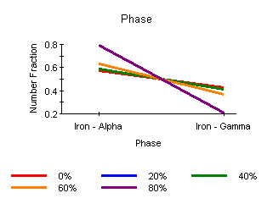
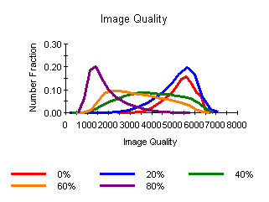
2- Phase hardening in a cold-rolled α/γ steel
EBSD analysis limits
0%
20%
40%
60%
80%
α
TEM
RD
γ
TD
(Brisset, Baudin, Jura, Mater. Scien. Forum. , 2010)

Slide 8
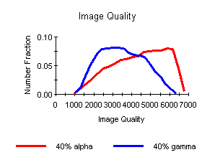
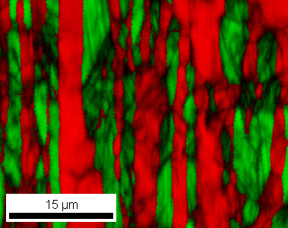
2- Phase hardening in a cold-rolled α/γ steel
EBSD Image Quality
(Stored Energy Estimation )
γ
α
0%
40%
α
With EBSD, the IQ factor decrease
can be qualitatively related to the strain hardening.
γ
40%
E_{sto} γ phase > E_{sto} α phase

Slide 9
TEM observations
(Stored Energy Estimation )
The material is not completely free of dislocations after hot rolling
The stored energy (E_{sto}) increases with the cold rolling reduction:
up to 35 J/mol in the γ phase and up to 20 J/mol in the α phase (neutron).
The E_{sto} mean value is nearly the same in both phases for the hot rolled specimen and is lower than 6 J/mol (neutron).
γ
α
α
γ
0%
60%
E_{sto} γ phase ≈ E_{sto} α phase
E_{sto} γ phase > E_{sto} α phase
(Etter, Baudin, Mathon, Swiatnicki, Penelle, Scripta Mater., 2006)

Slide 10
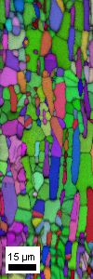
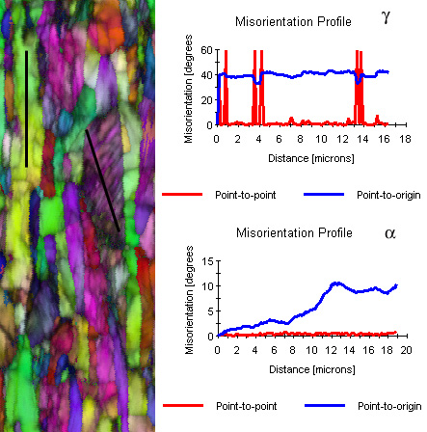
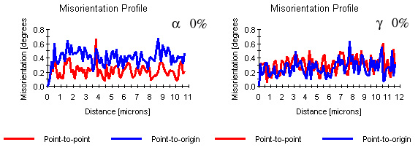
EBSD /TEM correlation
(Strained phase microstructure)
Cold rolling reduction \ Phase | Ferrite | Austenite
0% | Recrystallized with some dislocations | Recrystallized with some dislocations
40% | Dislocation walls or microbands | Most of grains have twins, some microbands can cross α/γ interface
TEM
EBSD
TEM
0%
0%
α
α
α
40%
γ
γ
γ
γ
40%
40%
α
γ
γ
α
0%
40%
α
(Swiatnicki, Baudin, Jura, Mathon, Buraczynska, Problems of Mater. Sci.2003)

Slide 11
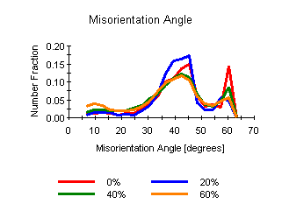
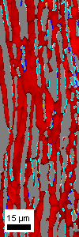
EBSD
(Grain boundary analysis )
Misorientation Angle
Twins : Σ3 boundaries
20%
Phase orientation relationships
Tendency is to loose high angle boundaries for low angle boundaries.
Decrease of twin boundaries.
Phase orientation relationships tend to disappear with cold rolling.
(B) Bain, K-S (Kurdjumov-Sachs), N-W (Nishiyama-Wassermann) G-T (Greninger-Troiano) orientation relationships

Slide 12
2- Phase hardening in a cold-rolled α/γ steel
Conclusions
As the rolling reduction increases (above 20%) fraction of the particular phase orientation relationships decreases.
The increase of the cold rolling reduction generates a rotation of the grains which tends to reduce the fraction of these types of orientation relationships.
2- Identically, twin grain boundary percentage decreases (in the γ phase) as the deformation amount increases.
During cold-rolling, the decrease of Σ3 boundaries (from hot rolling) is not balanced by the apparition of deformation twins in the γ phase.

Slide 13
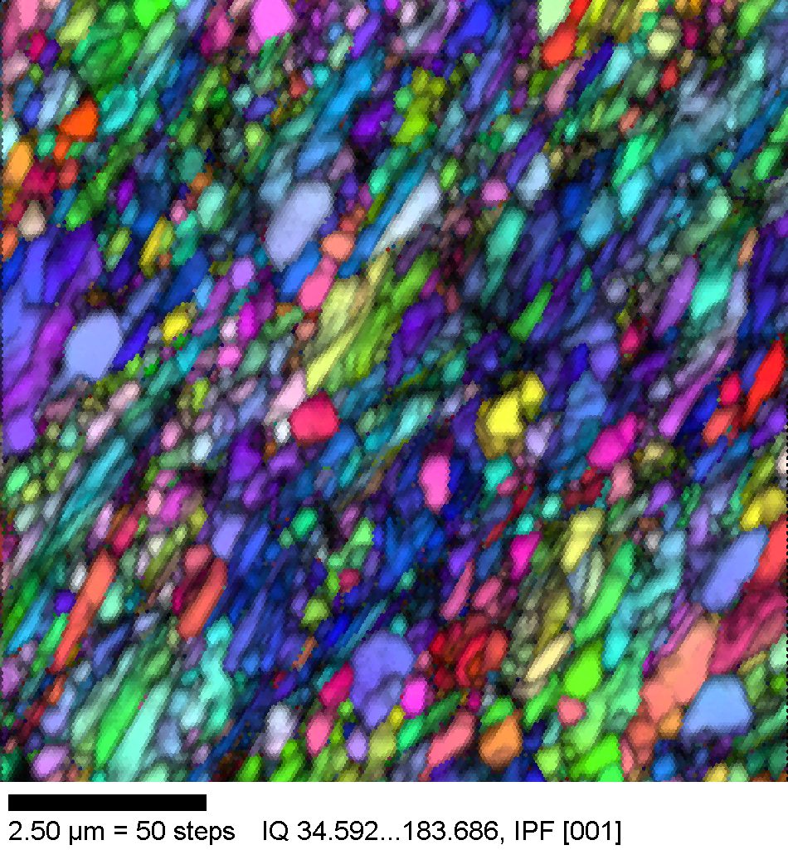
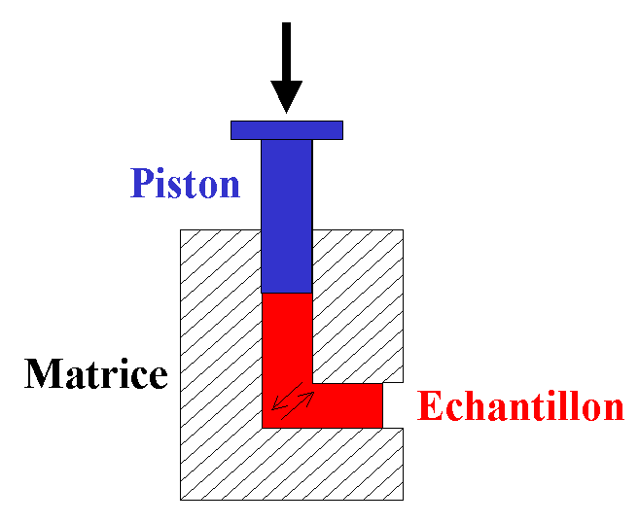
3- Sub-micron copper produced by ECAE
Copper
φ_{ini}= 40 µm
Mechanical properties
FEG/EBSD
ECAE, ε ∼ 8
ECAE
Hardness Vickers
DE
Extrusion number
DN
Saturation around 160 HV

Slide 14
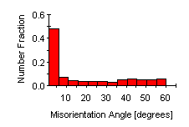
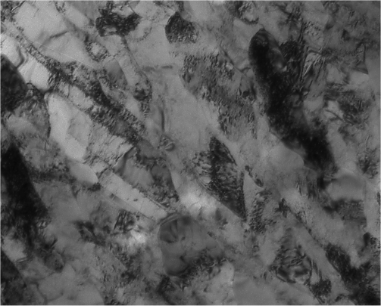
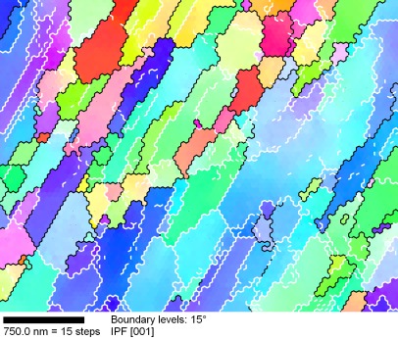
3- Sub-micron copper produced by ECAE
MICROSTRUCTURE AFTER 8 CYCLES
A sub-micron grained copper is not obtained despite the hardness saturation
Clusters of adjacent sub-grains with the same orientation
Persistence of elongated grains
FEG/EBSD
TEM
DE
200 nm
DN
DE
(MSSMat, ECP)
DN

Slide 15
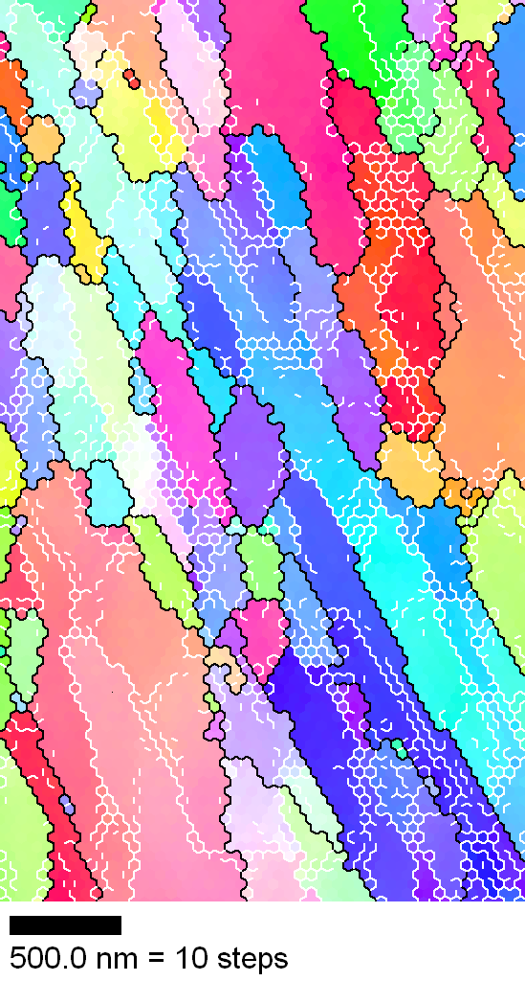
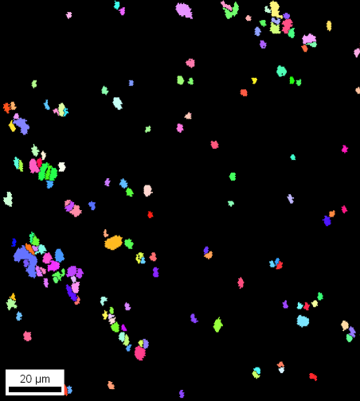
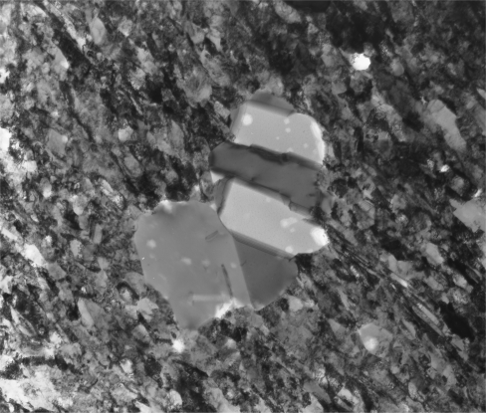
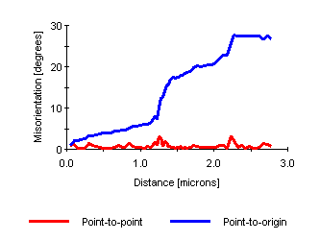
3- Sub-micron copper produced by ECAE
EBSD
TEM observations
ECAE, ε ∼ 8
FEG
Last shear direction
SEM
ND
1 µm
200 nm
ED
DN
Dynamically Rex Grains in deformed matrix
Sub-grain size = 0.4 µm
Not a real submicron-grained copper
DE
(Etter et al., Mater. Charact., 2006)

Slide 16
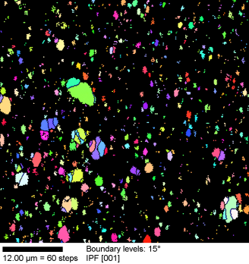
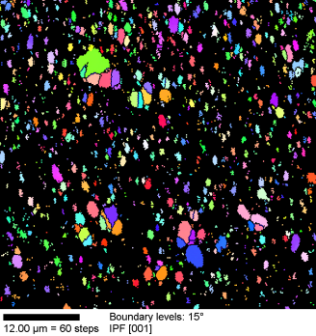
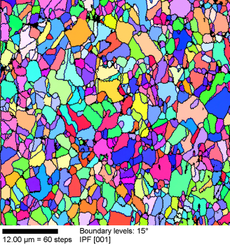
EBSD
(Grain size stability during annealing at 200°C)
ECAE
30s
7 min30s
ND
ED
0.4 µm
1.5 µm
Grain size < 2 µm

Slide 17
3- Sub-micron copper produced by ECAE
Conclusions
Copper by ECAE ➔ “submicron-grained (SMG) microstructure”, cell/subgrain size of 0.4 µm.
After ECAE, the most distinct feature in the microstructure is the formation of dynamically recrystallized grains in the cold-worked matrix composed of elongated cells.
Annealing during 7min30s at 200°C ➔ complete recrystallized microstructure, low and stable average grain size of about 2 µm.

Slide 18
Conclusion
EBSD and TEM are successfully correlated to study the strained states of several metals and alloys:
EBSD ➔ statistical values (misorientation, boundary characterization)
TEM ➔ dislocations, sub-structure as a function of crystallogaphic orientation, local texture.
Ecole des Mines St Etienne A.L. Helbert 5 mai 2010

